Slide 1
How to configure the display of user pictures on the User Details and Patrons Services page in Alma
Yoel Kortick
Senior Librarian

Slide 2
User Pictures
See also: Managing User Pictures
It is possible to display pictures of users in Alma on the User Details and Patron services page.
This is done by placing pictures of the users on an external server using a naming convention which matches one of the identifier types.
In the example here we will place photos with suffix .png on an external server and each photo will be named the same as the barcode of the corresponding user.

Slide 3
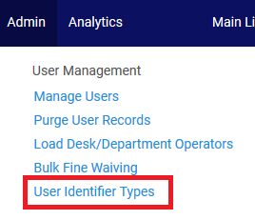
User Pictures
Step One
Decide which identifier you want to use as the name of the pictures and define it in “User Management > General > Other Settings > photo_identifier_type”
We will use the barcode which is code “01”. Here we see the user identifier types:

Slide 4
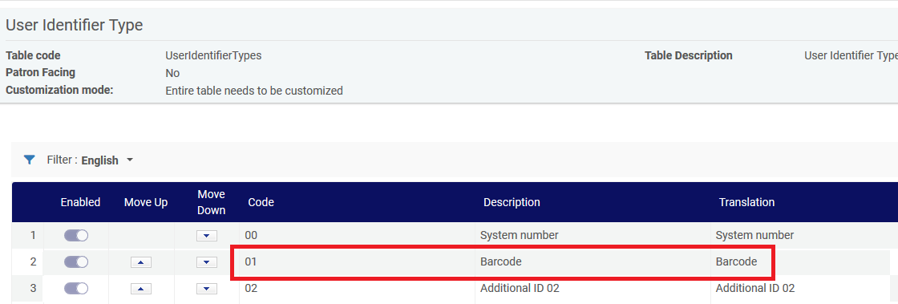
User Pictures

Slide 5
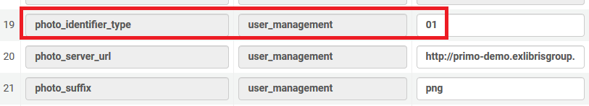
User Pictures
We define it as follows in the photo_identifier_type

Slide 6
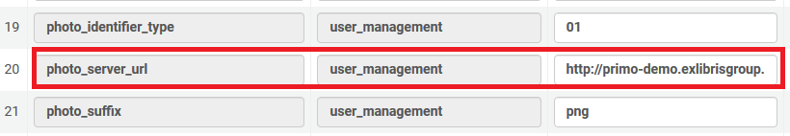
User Pictures
Step Two
Decide where you will put the picture files.
We will put the pictures in server “primo-demo.exlibrisgroup.com” in directory “bor_pics”.
Therefore we will define in “User Management > General > Other Settings > photo_server_url”:
http://primo-demo.exlibrisgroup.com:8991/bor_pics/

Slide 7
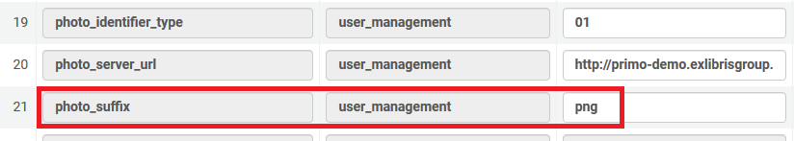
User Pictures
Step Three
Decide what kind of suffix your picture photos will have, for example jpg, png, gif etc.
We will use png. Therefore we will define in “User Management > General > Other Settings > photo_suffix”: png:

Slide 8
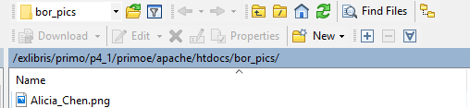
User Pictures
Step Four
Put photos on the server in the directory with the suffix.
We will look at example Alicia_Chen.png. It is on the specified server in the specified directory:

Slide 9
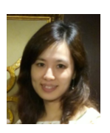
User Pictures
This is the photo from the server

Slide 10
User Pictures
Step five
Retrieve a patron who has a barcode which is the same as a picture on the server (without the suffix “.png”).
On the next slide is patron with barcode “Alicia_Chen”, and we see that the photo “Alicia_Chen.png” from the server appears in the user details page.

Slide 11
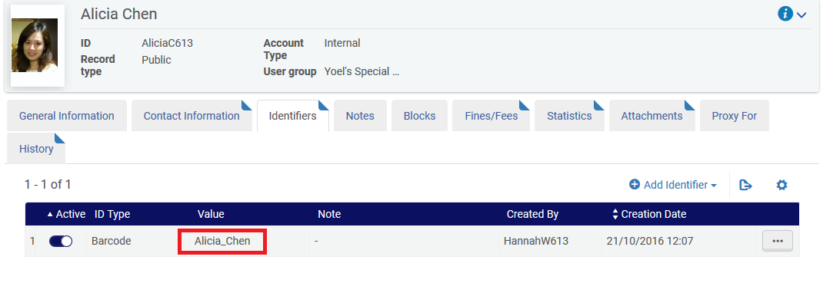
User Pictures

Slide 12
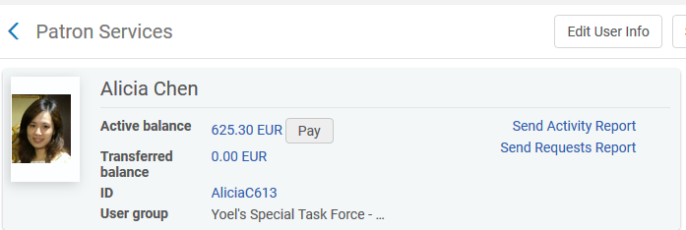
User Pictures
The photo also appears on the patron services page:

Slide 13
Yoel.Kortick@exlibrisgroup.com

